Slide 1
Heart sounds and murmurs
Dr D T D Warnakulasuriya

Slide 2

STETHISCOPE
HISTORY
Rene Laennec first described a devise for auscultation of heart sounds. ( France 1816)
Golding Bird described the flexible stethoscope. (1840)
Arthur Leared
George Camman ( 1852)
David Littmann ( 1960)
Ear Piece
Bell
Diaphragm
Notes:
David Littmann ( 1960) – harvered proff, lighter and improved acoustics

Slide 3
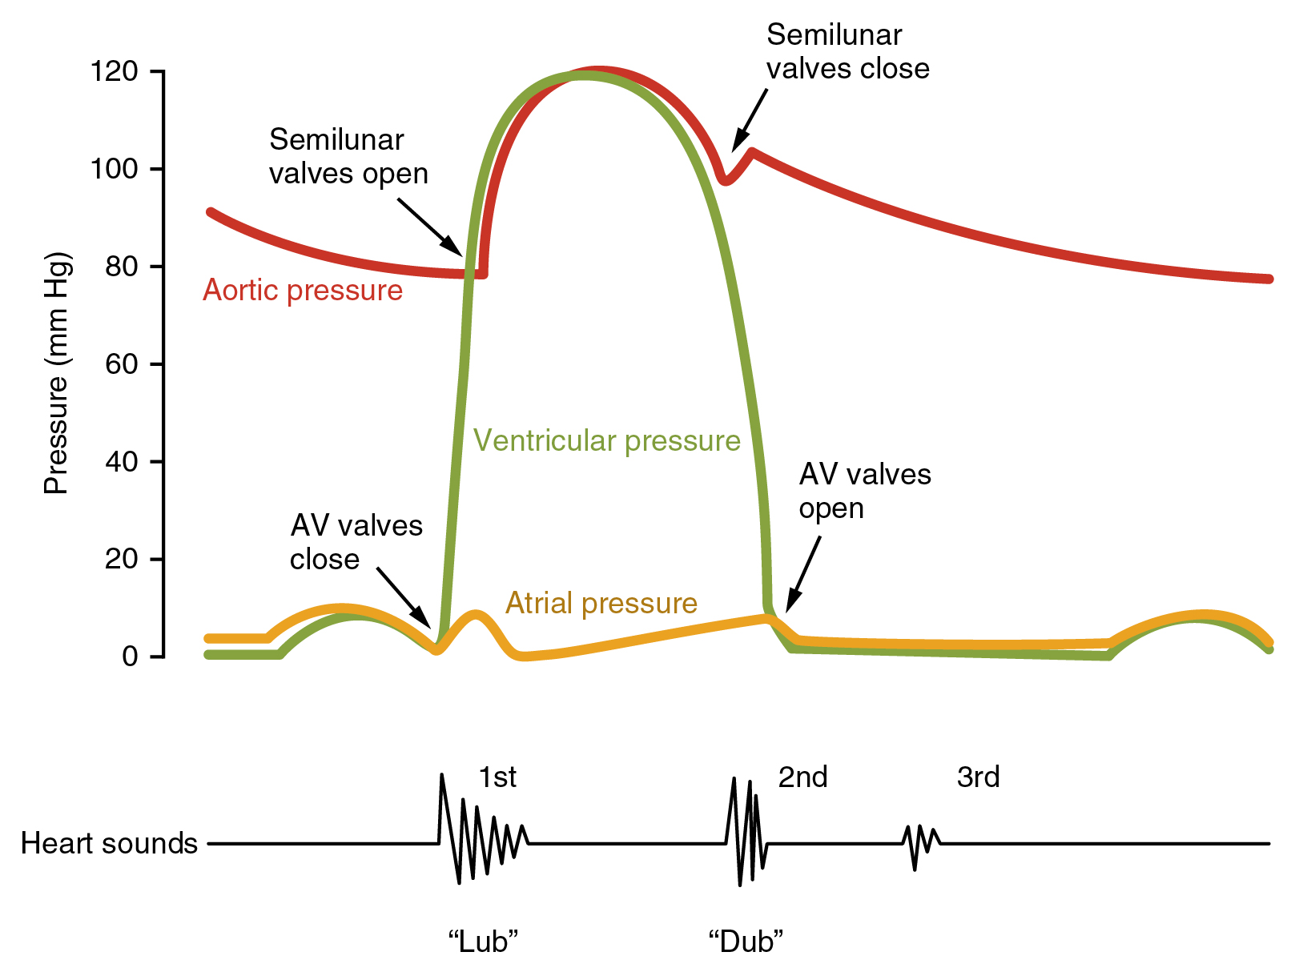
Heart sounds
Produced by vibration of the taught heart valves immediately after closure of the valves.
These vibrations travel through the tissues to the chest wall.
Opening of normal valves do not cause a sound.
4th

Slide 4
Heart sounds
1st heart sound-‘lub’
Low pitched , slightly prolong ( 0.15s).
Produced by the closure of tricuspid and mitral valves.
At the start of ventricular systole.
2nd heart sound – ‘dub’
High pitched, short (0.12s) loud and sharp.
Produced by aortic and pulmonary valve closure
Follows ventricular systole.
In Inspiration – physiological splitting of the second heart sound. ( aortic component before the pulmonary)

Slide 5
4th

Slide 6
3rd heart sound
Soft low pitched sound in early diastole
Physiological in young adults
Rapid filling of ventricles following AV valve opening with a little elastic resistance on the ventricular wall created by the initially filled volume of blood.
4th heart sound
Late in diastole
Mostly pathological
Atrial contraction causing rapid ventricular filling on a tense ventricular wall.

Slide 7
S1
A2
P2
S3
S1
Systole
Diastole

Slide 8
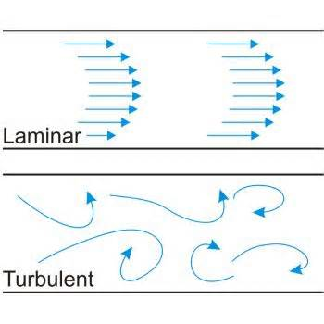
Heart Murmurs
Normal flow is lamina, non turbulent and silent.
Murmurs are abnormal sounds heard when there is turbulent flow with in the heart or blood vessels.
Lamina flow – Concentric layers of fluid moving with a high velocity at the center of the vessel and a low velocity along the walls.

Slide 9
Ohms law
Flow= pressure/resistance
With increasing pressure flow should increase if the resistance is static
But with increase in pressure beyond a limit does not increase the flow in a liner fashion. This is due to turbulence.

Slide 10
Reynolds Number
Point where laminar flow becomes turbulent.
Equation
Reynold's number = (2 x diameter x velocity x density)
viscosity
Re <2000 = lamina flow
>3000= highly turbulent flow

Slide 11
Turbulence can be created by
Abnormal valves
Narrow/ stenosed valves – accelerated flow
Incompetent – regurgitant /backward flow
Abnormal or high flow through normal valves and vessels
High flow in pregnancy
Low viscosity of blood in anemia
Abnormal communications between heart chambers

Slide 12
Characteristics of a murmur
Loudness
Quality
Location
Timing
Loudness – Depends on the turbulence of flow not the severity of the lesion
Quality – Pitch of the murmur. ( low, medium or high)

Slide 13
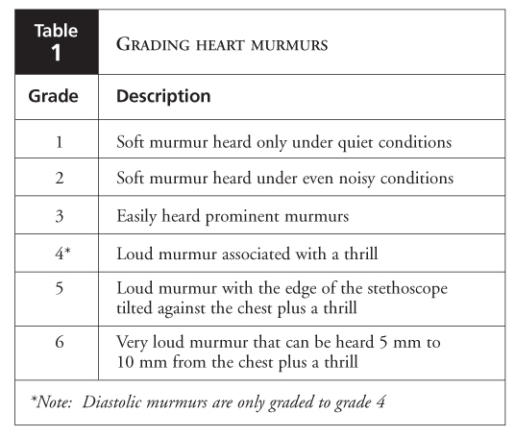

Slide 14
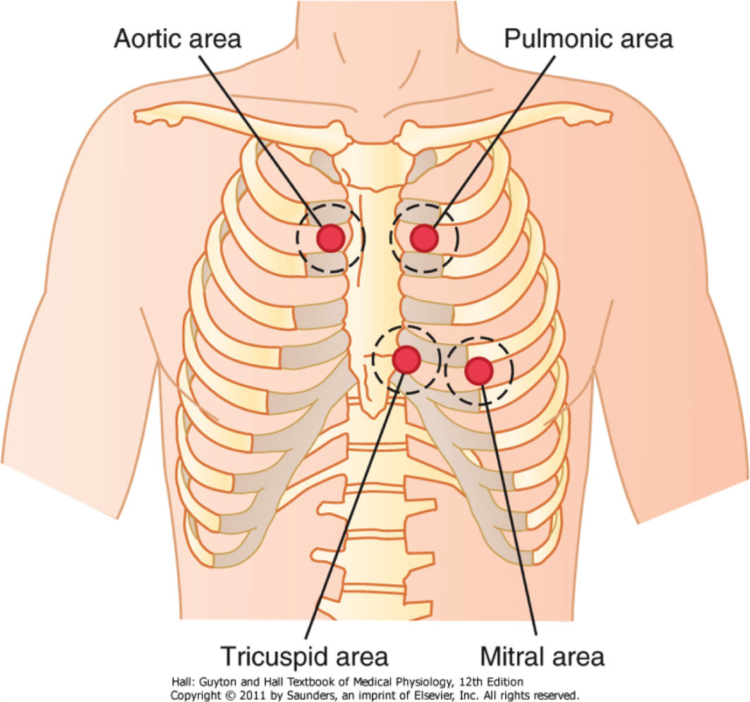
CARDIAC AREAS FOR AUSCULTATION
Aortic area - Upper right sternal edge
Pulmonary area – upper left sternal edge
Tricuspid area – lower left sternal edge
Mitral area - Apex
Notes:
Areas where sounds from each valve are best herd
May not be directly above the structure as the flow of blood causing the vibrations create the sounds

Slide 15
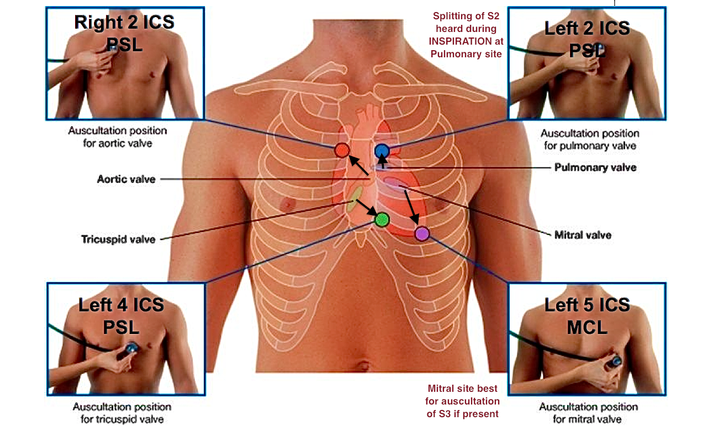

Slide 16
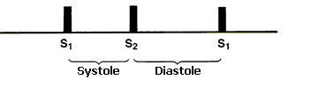
Timing – Phase of the cardiac cycle.
Systolic (between the first and second heart sounds)
Mid systolic
Late systolic
Pan systolic
Diastolic ( between the second and the first heart sounds)
Early diastolic
Mid diastolic
Pre-systolic
Continuous murmurs are heard during both phases of the cardiac cycle.

Slide 17
Murmurs in valvular disease
 | SYSTOLIC | DIASTOLIC
Mitral area | Mitral regurgitation | Mitral stenosis
Tricuspid area | Tricuspid regurgitation | Tricuspid stenosis
Aortic area | Aortic stenosis | Aortic incompetence
Pulmonary area | Pulmonary stenosis (Infundibular stenosis) | Pulmonary incompetence

Slide 18
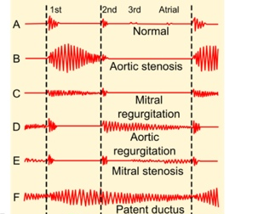

Slide 19
Congenital heart diseases causing murmurs
Heart Disease | Systolic murmur | Diastolic murmur
ASD | + With Fixed splitting of the second heart sound
VSD | + (Pan systolic murmur)
PDA | + | +

Slide 20
Changes in S1 and S2 heart sounds in pathological conditions
Heart sound | lesion | Changes to heart sound
S1 | Mitral Stenosis | Early- Accentuated
 |  | Late - soft
S2 | RBBB | Exaggerated/wide splitting
 | ASD | fixed splitting
 | LBBB and aortic stenosis | Reversed splitting
 | Severe aortic stenosis | Single absent aortic component
 | Severe pulmonary stenosis Tetrology of Fallot | Single absent pulmonary component

Slide 21
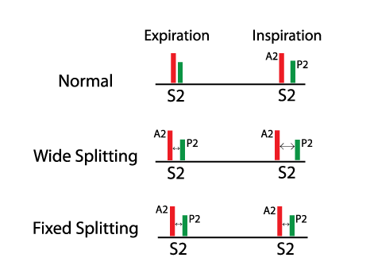

Slide 22
Conditions causing S3 and S4 heart sounds to appear
S3
High output states ( Anemia, Fever, Pregnancy, thyrotoxicosis)
Left ventricular failure
Mitral regurgitation
Constrictive pericarditis
S4
Hypertension
Aortic stenosis
Hypertensive cardiomyopathy

Slide 23
Murmurs in valvular disease
Timing |  | Aortic | Pulmonary | mitral | tricuspid
Systolic | Mid systolic | AS HCM | PS Infundibular stenosis
 | Late systolic |  |  | MVP
 | Pan systolic |  | VSD | MR | TR
Diastolic | Early diastolic | AR | PR
 | Mid diastolic | Austin Flint Murmur in AR |  | MS | TS
 | Pre-systolic |  |  | MS | TS

Slide 24
Additional reading
Hutchison's clinical methods 23rd edition.
Kumar and Clark clinical medicine 8th edition.

